Slide 1
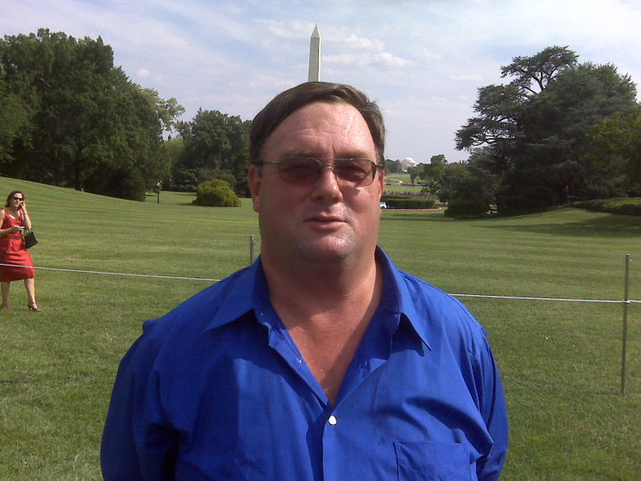
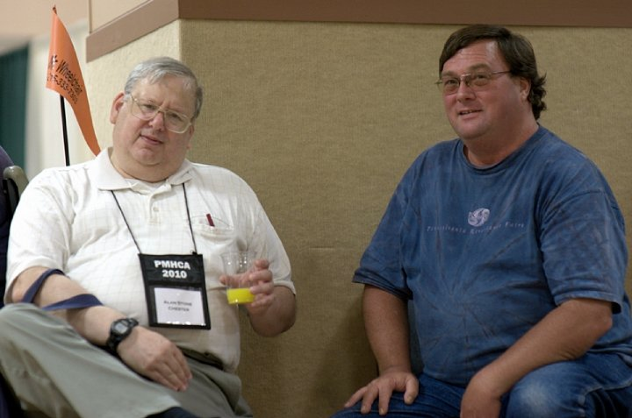
Remembering Glenn Koons
Living Inspiration& Advocate
RECOVERY LEADER,
Born 1958 – died at 53 August 31 2011 in Spring Township, PA

Slide 2
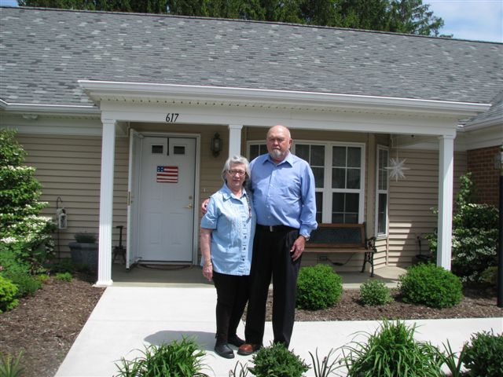
Loved Son of "Bud" & Joan Koons

Slide 3
Brother, Nephew, Uncle…
…Sister, Kathy, of Claysburg, PA, & several aunts, uncles, cousins, nieces, and nephews.
He was a 1975 graduate of Malvern, PA
Great Valley Senior High School
Electronic Engineering Technology
Certificate from RETS Electronic School

Slide 4
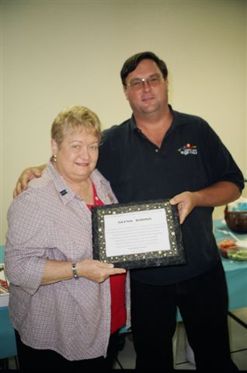
His impact on the community was tremendous!
He served as Southeast Region Community Support Program Coordinator for the Mental Health Association of Southeastern Pennsylvania.
He served on a variety of boards and committees, including the National Alliance on Mental Illness (NAMI) PA Board of Directors and Consumer Council, and the NAMI National Consumer Council, Restraint and Seclusion Committee, and Housing Committee.

Slide 5
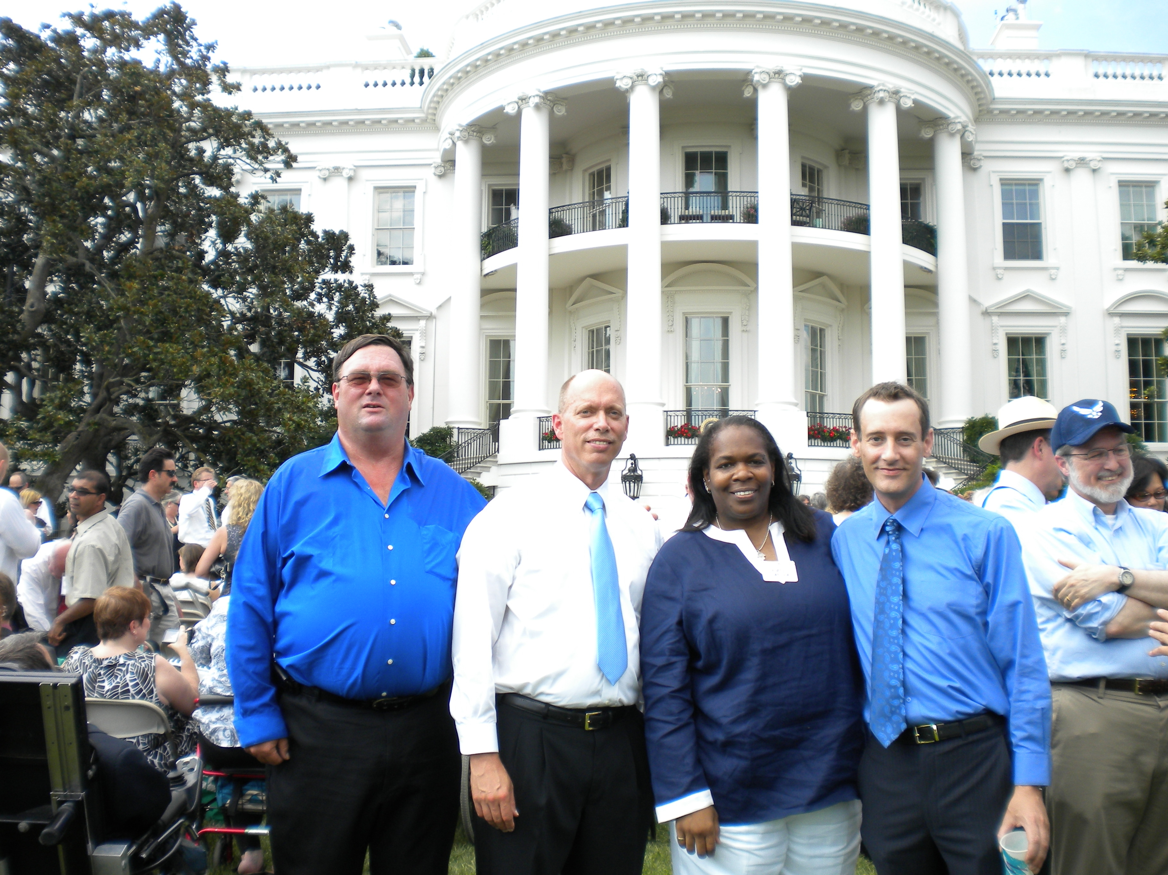
Glenn also was one of four NAMI National men who was recognized by President Obama at a reception celebrating the American with Disabilities Act (ADA) 20th anniversary.

Slide 6
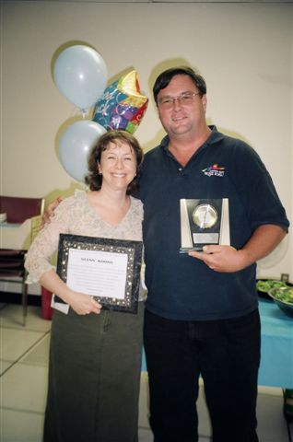
His Impact on the Community was Tremendous!
He was serving a three-year term on the Mental Health Association in Pennsylvania Board of Directors, for which he was Immediate Past President.
He also served on the Board of Directors for the Pennsylvania Mental Health Consumers’ Association, CareLink, and the Circle Lodge

Slide 7
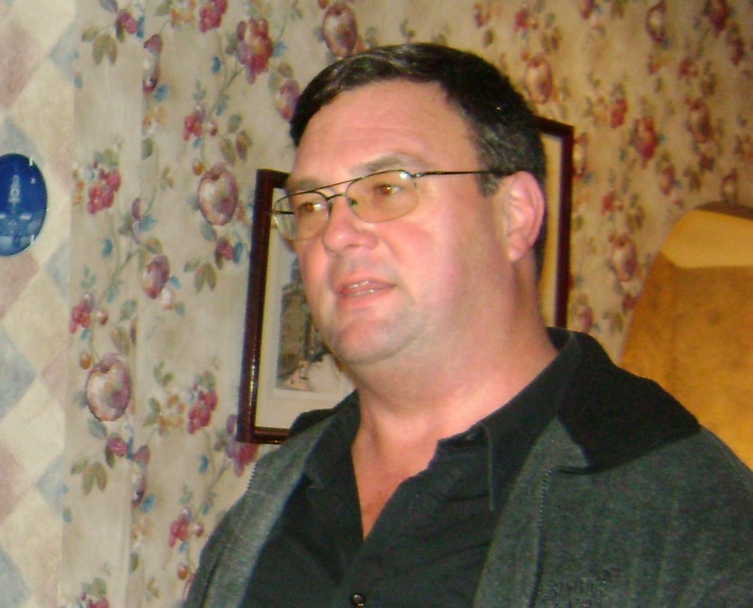
Friend, Advocate Supporter
Glenn was a wonderful person an was very helpful to me when I got involved with NAMI an Chester county CSP he will be missed
~ Stacey Taglieber

Slide 8
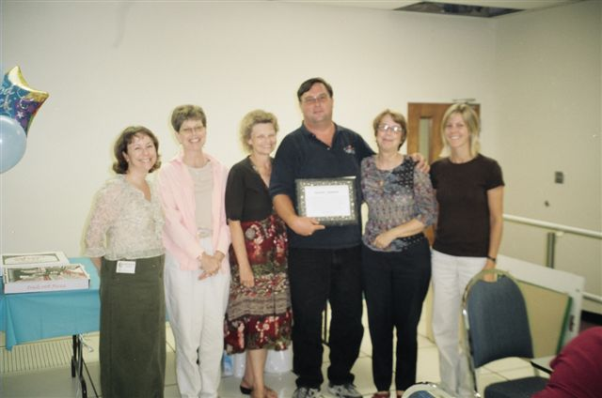
Certified Peer Specialist at Wernersville State

Slide 9
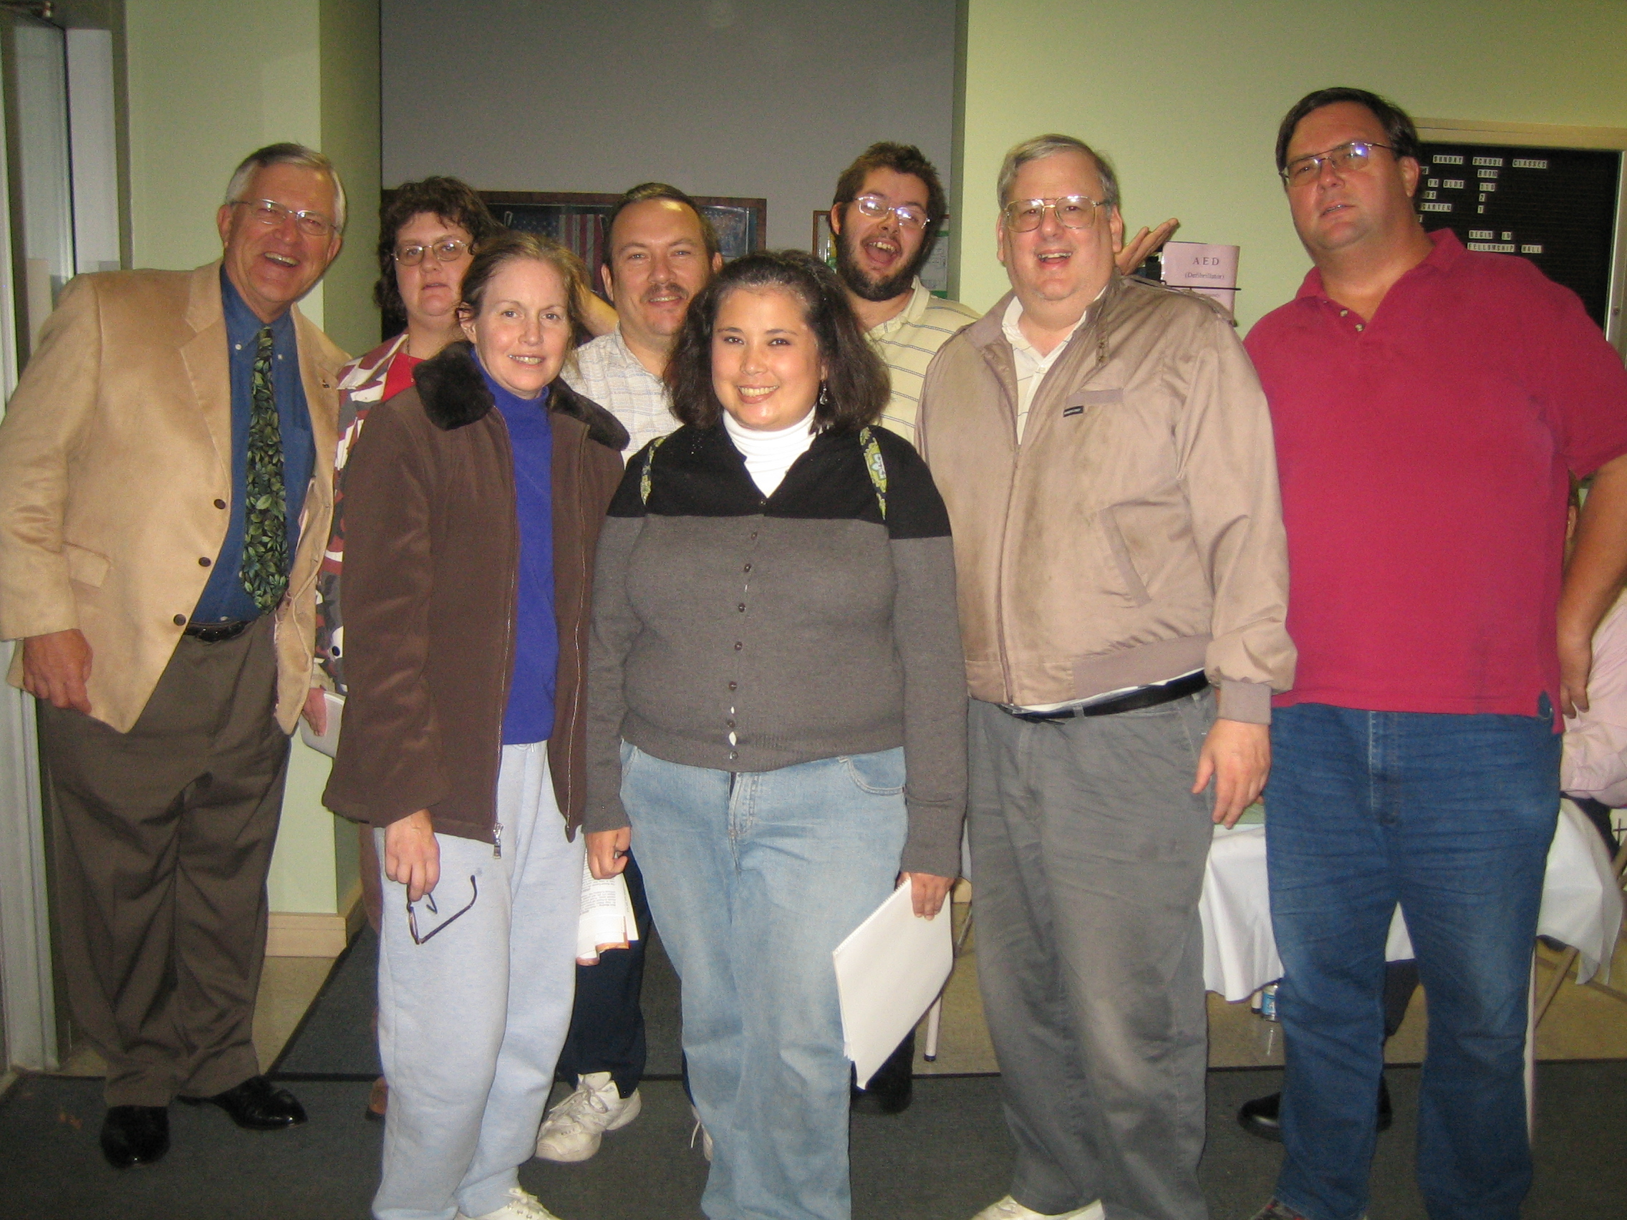
Glenn loved singing, listening to, and recording music, and playing the keyboard, guitar, and saxophone.
He also enjoyed spending time with his family in Martinsburg and loved all of the activities in the area, including bowling at Memorial Park and shopping in Altoona.

Slide 10
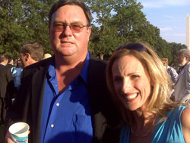
“I first met Glenn Koons when I was invited to speak at a luncheon in Montgomery County, Pa., being hosted by the National Alliance on Mental Illness.”
“It was one of the first speeches that I delivered after publication of my book and before my talk, NAMI Board Member Carol Caruso introduced me to Glenn. I was immediately struck by his easy-going manner. Carol bragged that Glenn was one of the first NAMI trained Peer-to-Peer mentors in the entire nation. Glenn and I spoke for several minutes and I was impressed by his thoughtfulness and enthusiasm.” - Pete Earley, bestselling author of The Hot House and Crazy

Slide 11
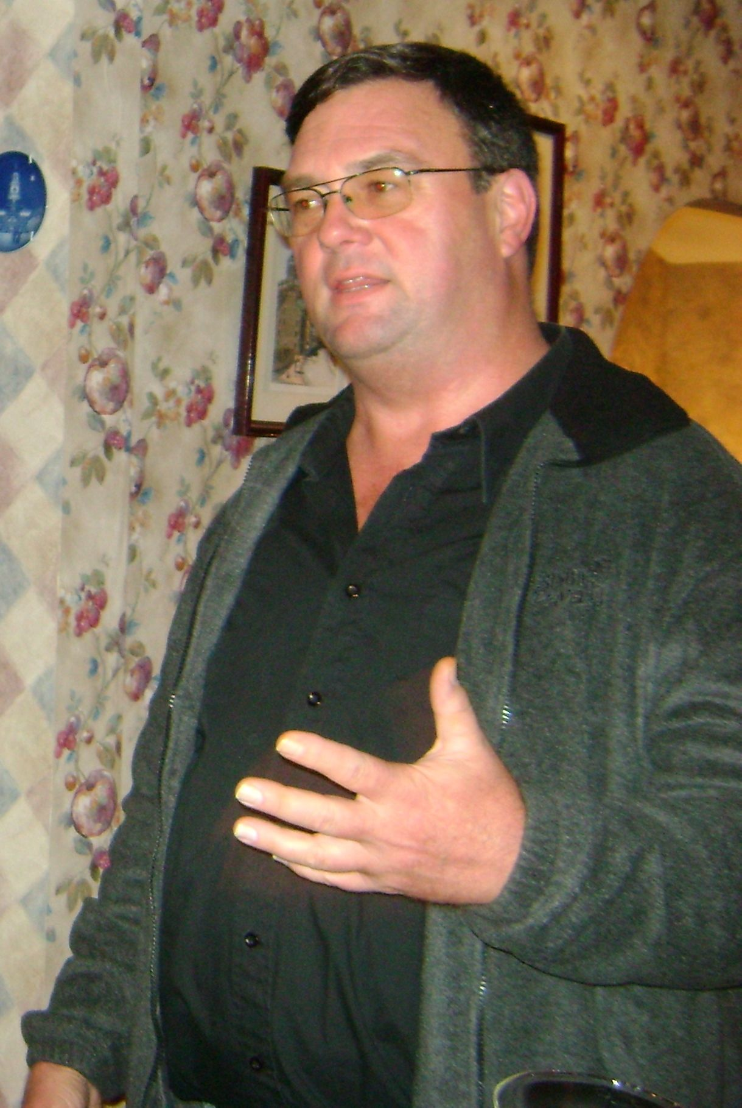
“Brighten Up Any Room”
What I remember most about Glenn were 3 things.
1. His laugh which could brighten up any room.
2. His gentleness and his compassion for others.
3. He was a hard worker and dedicated to helping others find their worth and possibility. Wendy Wood, PMHCA

Slide 12
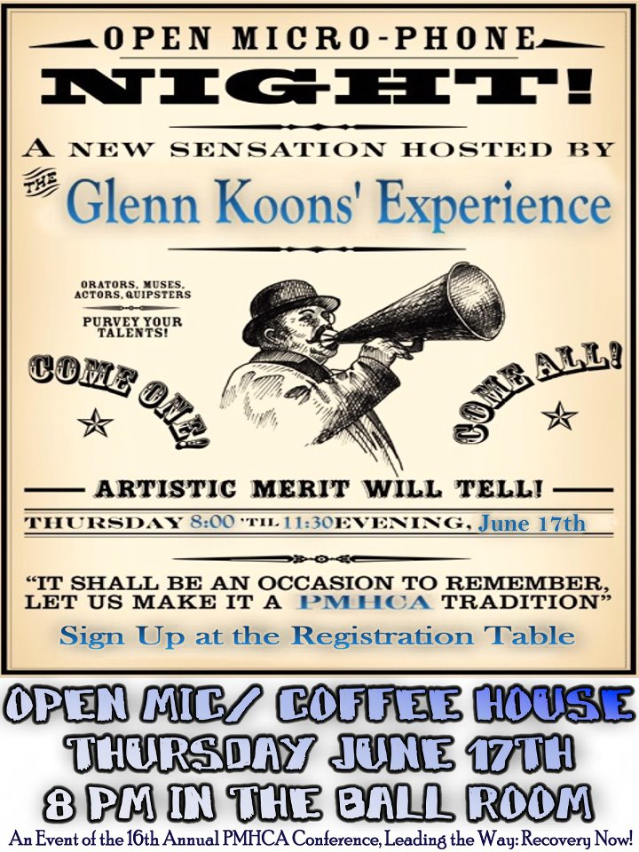

Slide 13
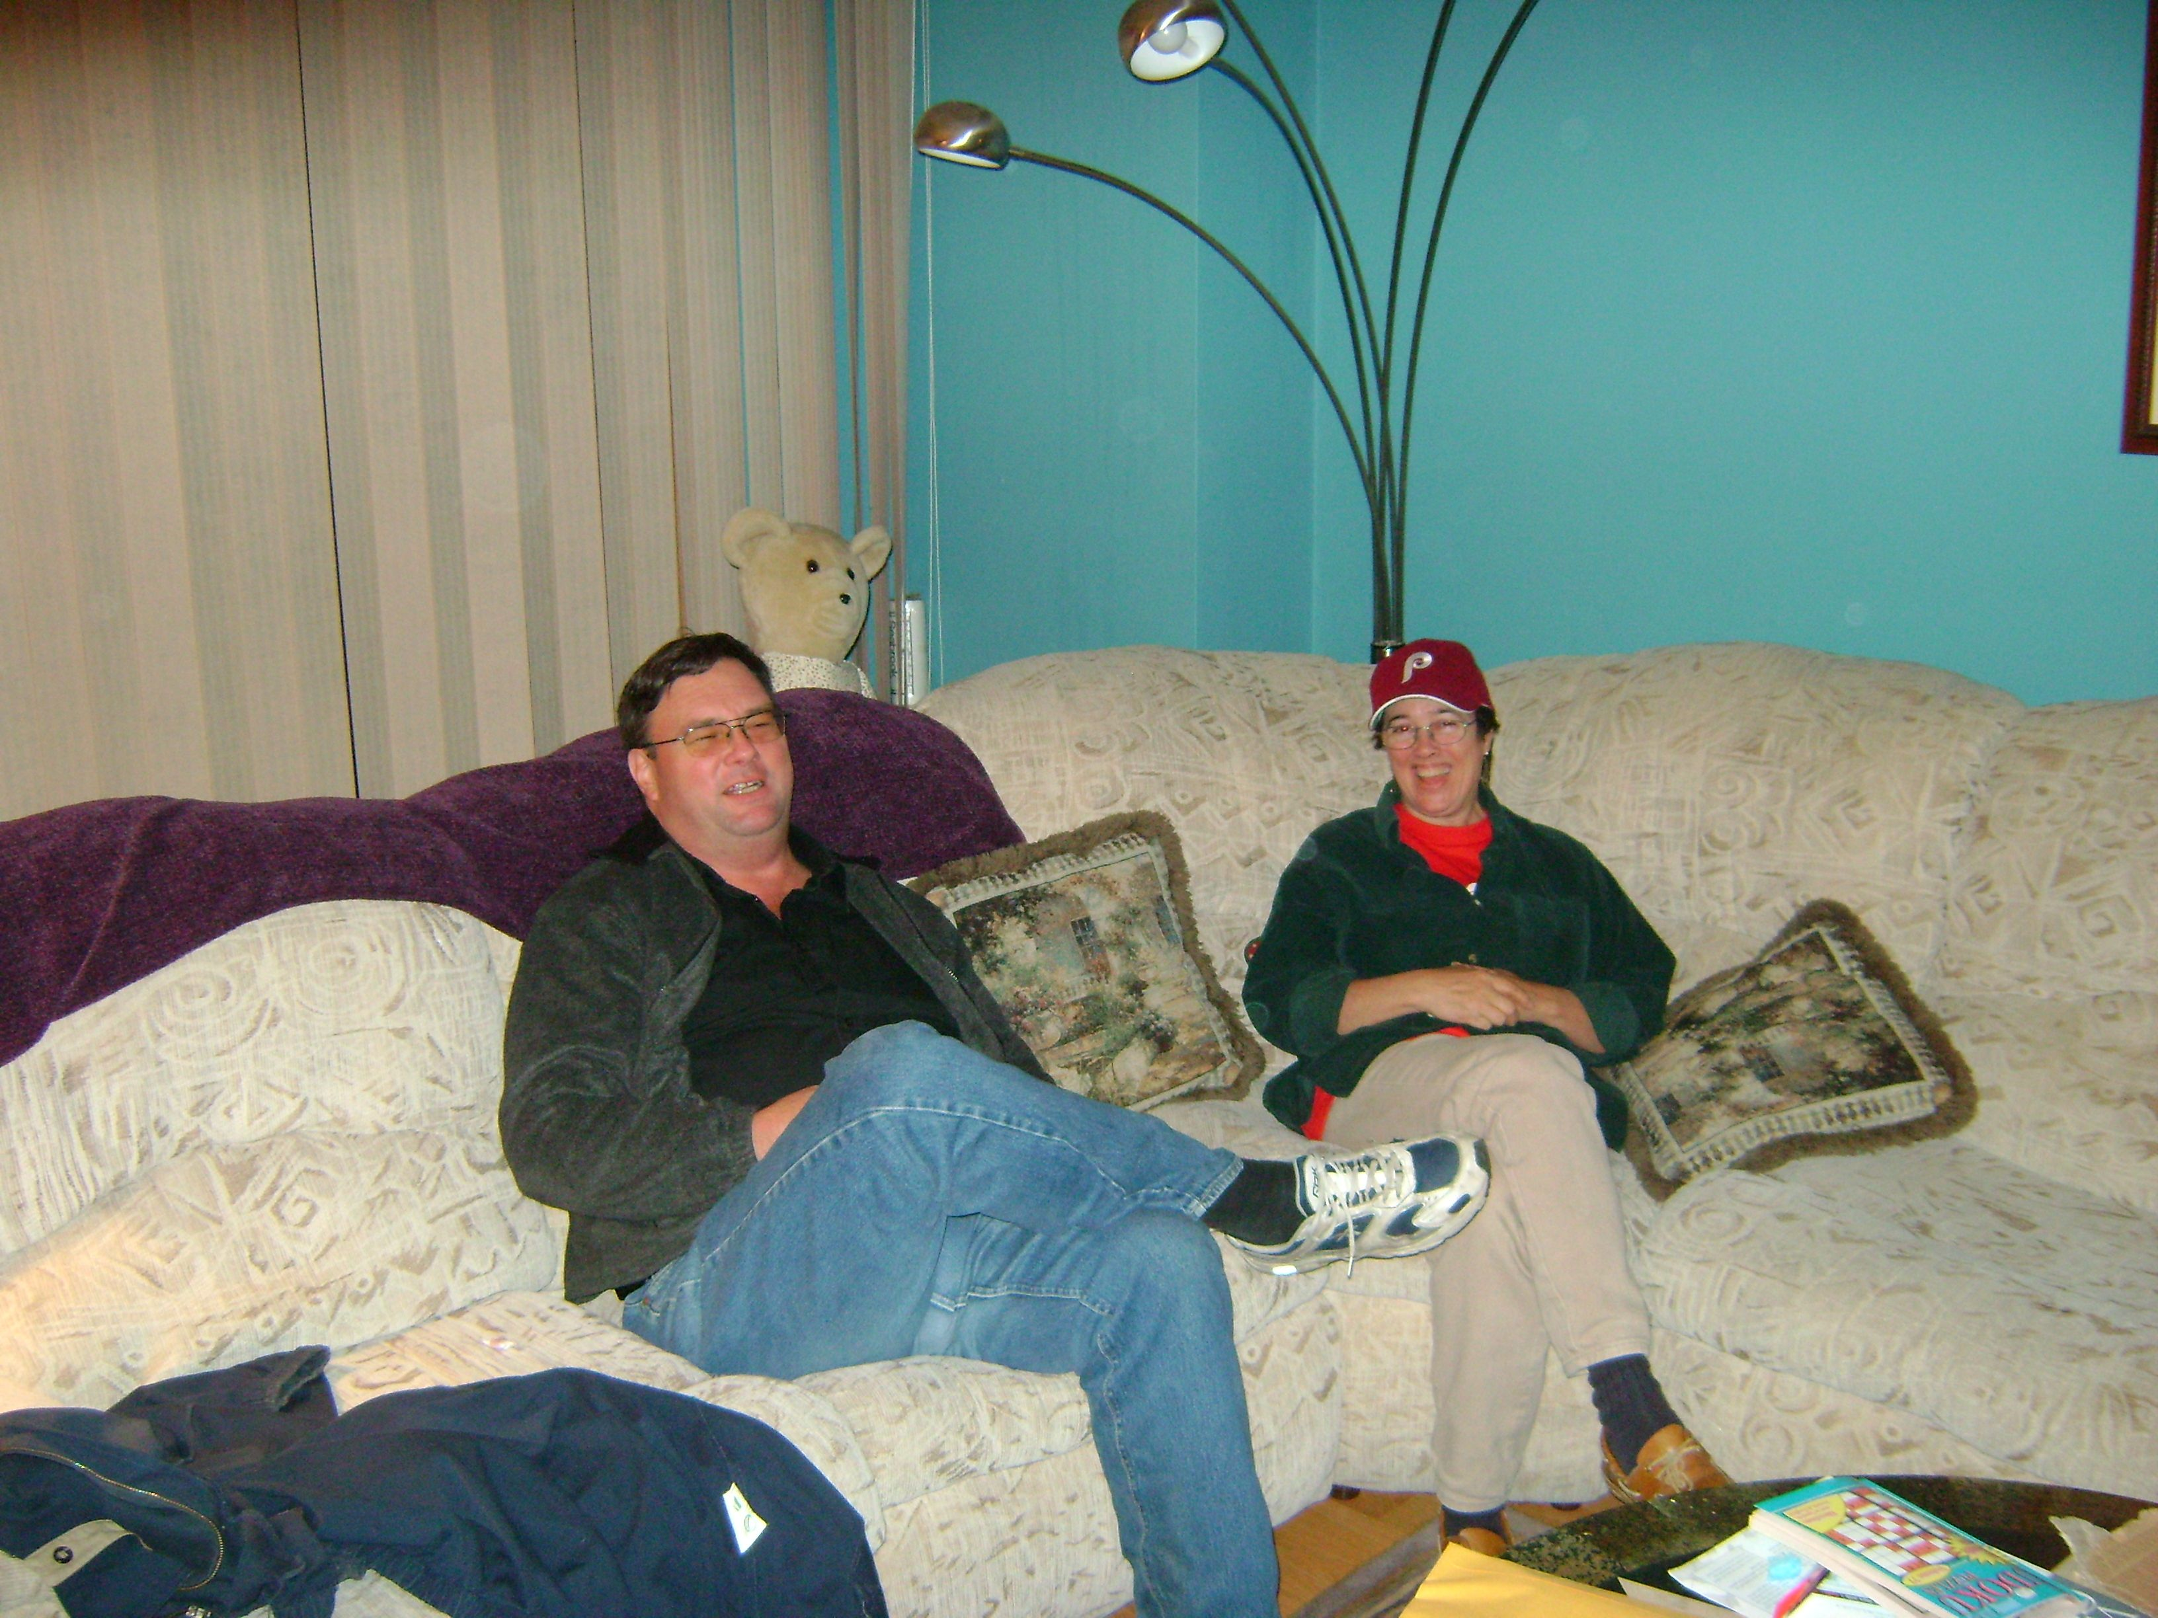
“I miss his joy at parties and big bear hug.”
“I had the joy of watching him blossom into a leader who brought folks together to advocate for us all.
I especially remember NAMI's voter registration program I Vote, I Count where he energized so many first time voters. “
- Karen Willimann

Slide 14
“Glenn was known by so many people”
“..and always helped someone in need. Glenn could talk to 1 person or Hundreds at a time and he was very compassionate with everyone. I will always remember how you helped me with your understanding and compassion.” ~ Alan Stone,

Slide 15
“He was an exceptional man and a role model for others, including me.”
“I got to know Glenn when we were neighbors in the southeast part of West Chester, and got to work with him on a number of local issues.. I am sorry to learn of his passing, and all I can offer to his family and friends is my testimony about how Glenn made other people's lives better.”
- Jim Jones West Chester Borough Council

Slide 16
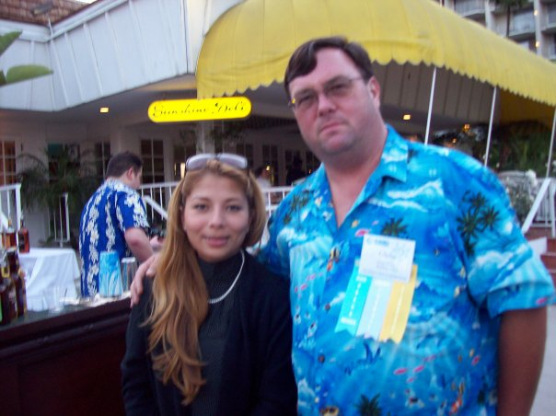
A Poem for Glenn
Passing Leaves by Gayle Bluebird
Glenn
Was the same
Everywhere—
Big bold dependable,
He eased into
Every situation—
Never announced
Or scheduled ahead,
He was there just
When you needed him,

Slide 17
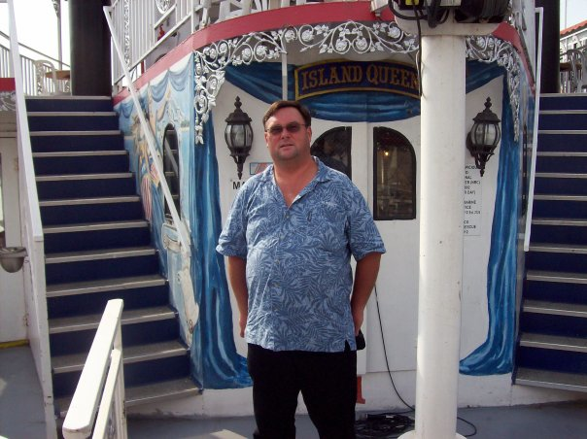
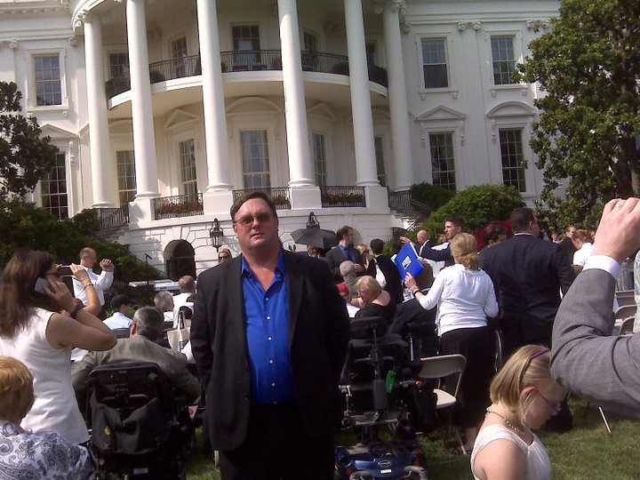
Passing Leaves
Lending a hand,
Fixing, adjusting,
Microphones, calling
Names up to stage
And remembering them--
We will miss him,
Like the seasons
That imperceptibly
Change—

Slide 18
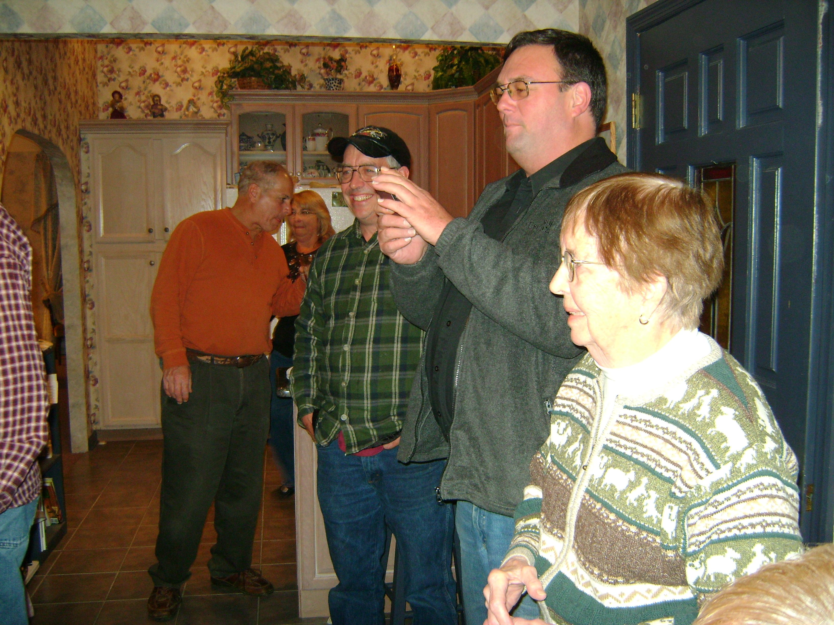
The leaves that fall With summer ending,
Leaves of golds and reds
Gifts, we say thank you
For, And waiting for winter
Frost we think of Glen
Among the leaves, our forever
Friend

